Slide 1
IMAGE SCRAPING AND CLASSIFICATION
Classification: Internal

Slide 2
Submitted By -
Komal Singh

Slide 3
Problem Statement
Images are one of the major sources of data in the field of data science and AI. This field is making appropriate use of information that can be gathered through images by examining its features and details.
The idea behind this project is to build a deep learning-based Image Classification model on images that will be scraped from e-commerce portal. This is done to make the model more and more robust.
This task is divided into two phases: Data Collection and Model Building.

Slide 4
Data Collection
The data is collected by scraping the images from Amazon.com.
The clothing categories used for scraping will be:
Sarees (women)
Trousers (men)
Jeans (men)

Slide 5
Data Collection
To scrape the images, Selenium is used.
The scraped images are then downloaded and saved into the destination folder in the .jpg format.
Labels are assigned to each class and are also saved in a csv format.

Slide 6
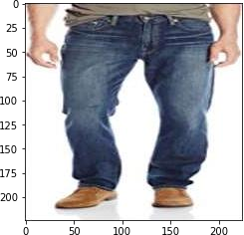
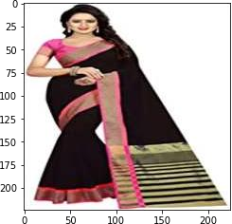
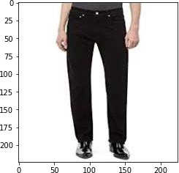
The Data

Slide 7
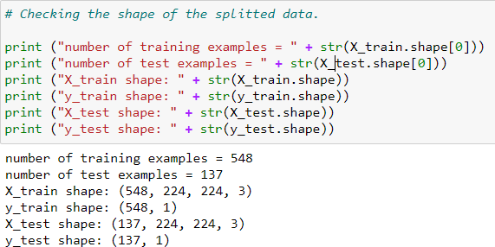
Splitting train and test data
The Data is first converted into array.
The data is splitted into training and testing data as X and y.
The train and test data is divided into 80% and 20% respectively.

Slide 8
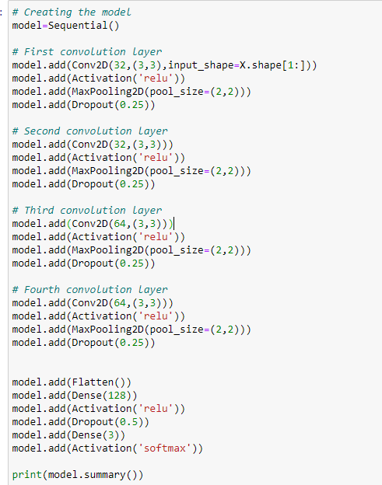
Model Building
The CNN model is build.
Activation functions :
‘Relu’ for hidden layers
‘Softmax’ for final/output layer
Optimiser used is ‘Adam’
Loss used is
‘sparse_categorical_crossentropy’
Metrics used is ‘accuracy’

Slide 9
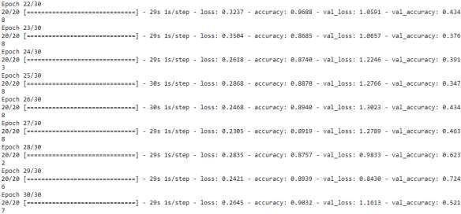
Results
The highest accuracy obtained is 90.32% at 30th epoch.

Slide 10
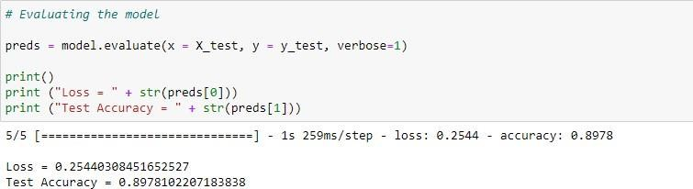
Evaluating the model
On testing/evaluating the model, the accuracy obtained is 89.78%.

Slide 11
Conclusion
The task of classifying images requires in-depth knowledge of the domain and expertise to identify anomalies in the image.
This is a multi-class classification problem.
In this project, we discussed the classification of images obtained from Amazon into saree, jeans and trousers, using Deep learning.

Slide 12
Thank You!

